Slide 1
Lesson 8: Introduction to Educational Media

Slide 2
Definition of Educational Media
A media for learning and teaching or learning software. Media itself means a method of communication
Educational media refers to channels of communication that carry messages with an instructional purpose. They are usually utilized for the sole purpose of learning and teaching (WebCrawler, 2013)
Educational media refers to materials, specimens, apparatus, software, hardware, and equipment used in teaching and learning at all levels.
Also known as: Instructional Media.
Notes:
Educational media refers to any materials, tools, or resources used to facilitate teaching and learning processes. This can include traditional forms of media such as textbooks, blackboards, and printed materials, as well as modern digital technologies like computers, tablets, and online resources. Educational media is designed to enhance instruction, engage students, and support learning outcomes. It can take various forms, including audio, visual, and interactive materials, and is used in diverse educational settings such as classrooms, libraries, and online learning environments.

Slide 3

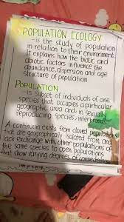

Types of Educational Media
Printed media
Books/Journals
Manilla Papers
Newspapers/Magazine

Slide 4

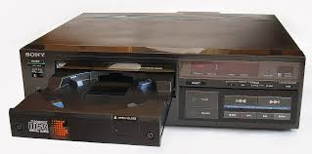

Types of Educational Media
Audio media
CD player
Radio
Musical Instruments

Slide 5


Types of Educational Media
Visual media
Film
Projector

Slide 6
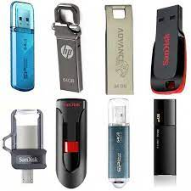

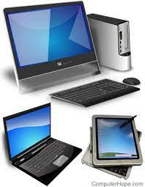
Types of Educational Media
Electronic media
Flash Disks
CD/DVD
Computers
Notes:
Use of the internet and social media

Slide 7


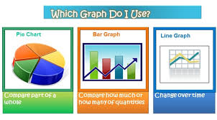
Types of Educational Media
Graphics
Notes:
Photos, Drawings, Bar graphs, Line graphs, Pie Charts for visual representation of information.

Slide 8


Types of Educational Media
Models
Notes:
Digital representations of objects or scenes in three dimensions.
They can be used to visualize complex concepts, such as anatomy, engineering designs, and historical artifacts, making them easier to understand and explore.

Slide 9
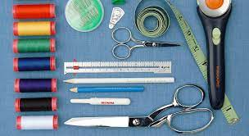

Types of Educational Media
Tools
Notes:
Tools used in different subjects: scissors, pliers, tape measure, screw drivers

Slide 10
Other forms of Educational Media
Community Resources E.g. Cattle dip, Game Park, Museum factory Snake Park, Agricultural Research Stations (KARLO)
Specimens: Live and preserved animals and plants.
Realia: Objects from real life that can be touched, smelt, seen, tasted
Apparatus: Thermometer, Syringe, beehive shelf, Voltmeters
Reagents: Used in science and applied sciences subjects e.g. Solutes, solvents, carbonates, oxides.
Notes:
Community Resources: These are facilities and objects that are found within the catchment area of a school and its environs and can be used for instructional purposes.

Slide 11

Which forms of Media do you use most?

Slide 12
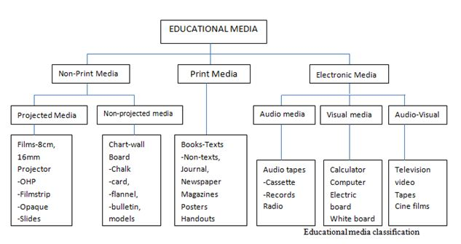
Notes:
Another classification of Educational Media

Slide 13
Purpose of Educational Media
Assists teachers in effective communication.
Provides opportunities for student participation.
Facilitates meaningful and permanent learning.
Promotes greater understanding of complex concepts.
Caters to individual differences in students.

Slide 14
Guiding Principles for Selecting Educational Media
Appropriateness for intended purpose/objectives/outcome.
Suitability to target audience/learners.
Accuracy and up-to-date information.
Physical qualities (design, simplicity, durability).
Cost-effectiveness.

Slide 15
Role and Significance of Educational Media
Arouse curiosity and create interest.
Motivate learners.
Sustain attention.
Clarify concepts and information.
Provide stimulus variations.
Supplement spoken word with visual material.
Present new ideas.
Stimulate discussion.
Summarize information.
Enhance retention and memory.
Add reality to teaching and learning.
Cater to individual differences.

Slide 16
Role of Teachers in Using Educational Media
Selecting appropriate media for specific learning objectives.
Integrating media effectively into lesson plans.
Providing guidance and support to students in using media.
Evaluating the effectiveness of media in enhancing learning outcomes.
Updating and adapting media to meet changing educational needs.

Slide 17
Challenges in Using Educational Media
Access to technology and resources.
Technical difficulties and maintenance issues.
Lack of training and expertise in using media.
Integration of media into existing curriculum and teaching methods.
Cost and budget constraints.
Ensuring media content is accurate, relevant, and up-to-date.

Slide 18
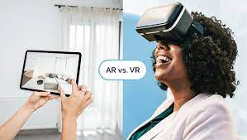
Future Trends in Educational Media
Virtual and augmented reality for immersive learning experiences.
Artificial intelligence for personalized learning and adaptive content.
Gamification and interactive storytelling for engagement.
Mobile learning and micro learning for on-the-go education.
Open educational resources (OER) and online platforms for global access to education.
Notes:
Mobile learning: apps, gaming, podcasts and audio learning. Example Duolingo for language learning.
Open educational resources (OER) are instructional and learning materials that can be found in the public domain. Examples: youtube lesson videos, learning simulations, online textbooks.
Moodle used for distance and open learning

Slide 19

What are the impacts of educational media on learning?

Slide 20
Impact of Educational Media on Learning Outcomes
Educational media has been shown to improve retention and recall of information.
It can enhance critical thinking and problem-solving skills.
Media-rich environments can increase student motivation and engagement.
Visual and interactive media can accommodate diverse learning styles and preferences.
Integrating media into instruction can lead to more effective and efficient learning experiences.

Slide 21
Ethical Considerations in Using Educational Media
Ensuring privacy and confidentiality of student information.
Avoiding bias and stereotypes in media content.
Providing equal access to educational media for all students.
Respecting intellectual property rights and copyrights.
Promoting responsible and ethical use of media for educational purposes.

Slide 22
Key Takeaways
Educational media is a diverse and essential tool for modern educators.
It enhances learning outcomes, engages students, and accommodates diverse learning styles.
Teachers play a crucial role in selecting, integrating, and evaluating educational media.
Visual and verbal presentations aid in learning abstract concepts.
Media caters to different learning styles (visual, auditory, kinesthetic).
Future trends in educational media include emerging technologies and innovative approaches.
Ethical considerations are important in the use of educational media.

